Slide 1

Results

Slide 2
Results
This section is the most important part of your paper because its function is to give specific answers to the aims that you stated in the introduction using an interesting sequence of text, tables, and figures
Notes:
You should use an interesting
sequence of text, tables, and figures to answer the study
questions and to tell the story without diversions.

Slide 3
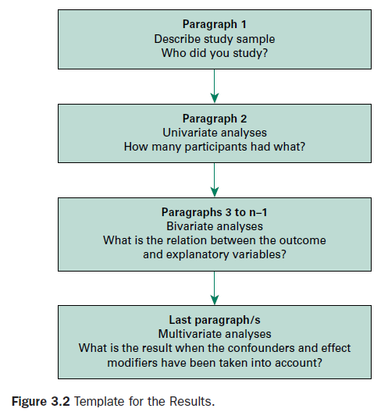
Notes:
Figure 3.2 shows a template for the structure.
The best way to present results is to gradually build up from univariate
statistics to describe the characteristics of your study sample,
through bivariate analyses to describe relationships between
your explanatory and outcome variables, and finally to
any multivariate analyses.
The length of the section should be
dictated entirely by how many results you have to present and
not by how much you want to say about them.

Slide 4
Results
Paragraph 1 of the results section should give accurate details of your study sample so that the generalizability of your results is clear.
In most papers, Table 1 is used to describe the details of the participants.
Notes:
This is important because epidemiologists will want to know the defining characteristics of your sample and
physicians will want to know if the participants in a clinical study are similar to their own patients.

Slide 5
Results ≠ Raw data
Avoid repeating the numbers that are already available in tables and figures
Describe what you found in the text and then back it up with results that are shown in a figure or a table
Notes:
You do not need to repeat numbers in the text that are already presented in a table or a figure.
A good trick to improve
readability is to describe what you found in the text and then
back it up with results that are shown in a figure or a table

Slide 6
Baseline characteristics
To describe the baseline characteristics of the participants in any type of study, always use a table and never use a figure.
The baseline characteristics also define the generalizability of your results.
Notes:
Thus, you need to describe the important characteristics of the study groups and show

Slide 7
Descriptive statistics
In any study, a percentage, the mean and its standard deviation, or the median and its interquartile range are the most appropriate descriptive statistics depending on the information that you are describing.

Slide 10
Results
Following paragraph 1, the next paragraphs will explain what your paper is really about because this is where you address the aims or test the hypothesis outlined at the end of the Introduction section.
In writing these paragraphs, only tell the readers what they need to know.
Notes:
Do not be tempted to add asides or include any data analyses that are drifting
away from the main purpose.
Topic sentences that begin each paragraph are useful for this. Table 3.2 shows an example of
how to use topic sentences to guide the reader through a results section.

Slide 11
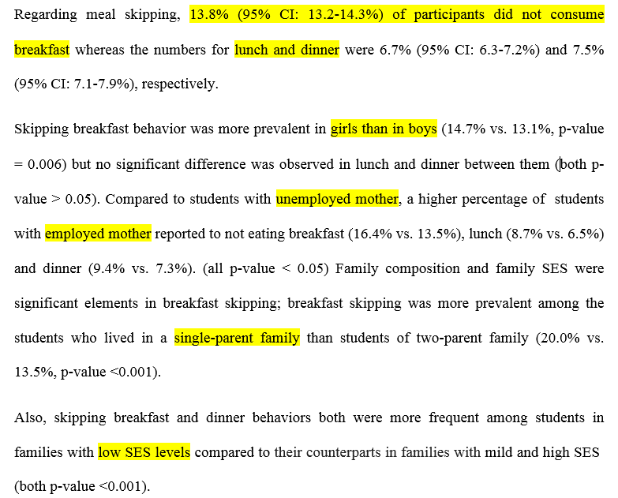
Notes:
Do not be tempted to add asides or include any data analyses that are drifting
away from the main purpose.
Topic sentences that begin each paragraph are useful for this. Table 3.2 shows an example of
how to use topic sentences to guide the reader through a results section.

Slide 13
Baseline characteristics
In many experimental and observational studies, you will need to demonstrate the comparability of the study groups at baseline:
“whether any potential confounders were unevenly distributed and were likely to cause an important bias that may have helped to explain the results”
Notes:
whether any potential confounders were unevenly distributed and were likely to cause an important bias that may have helped to explain the results.

Slide 14
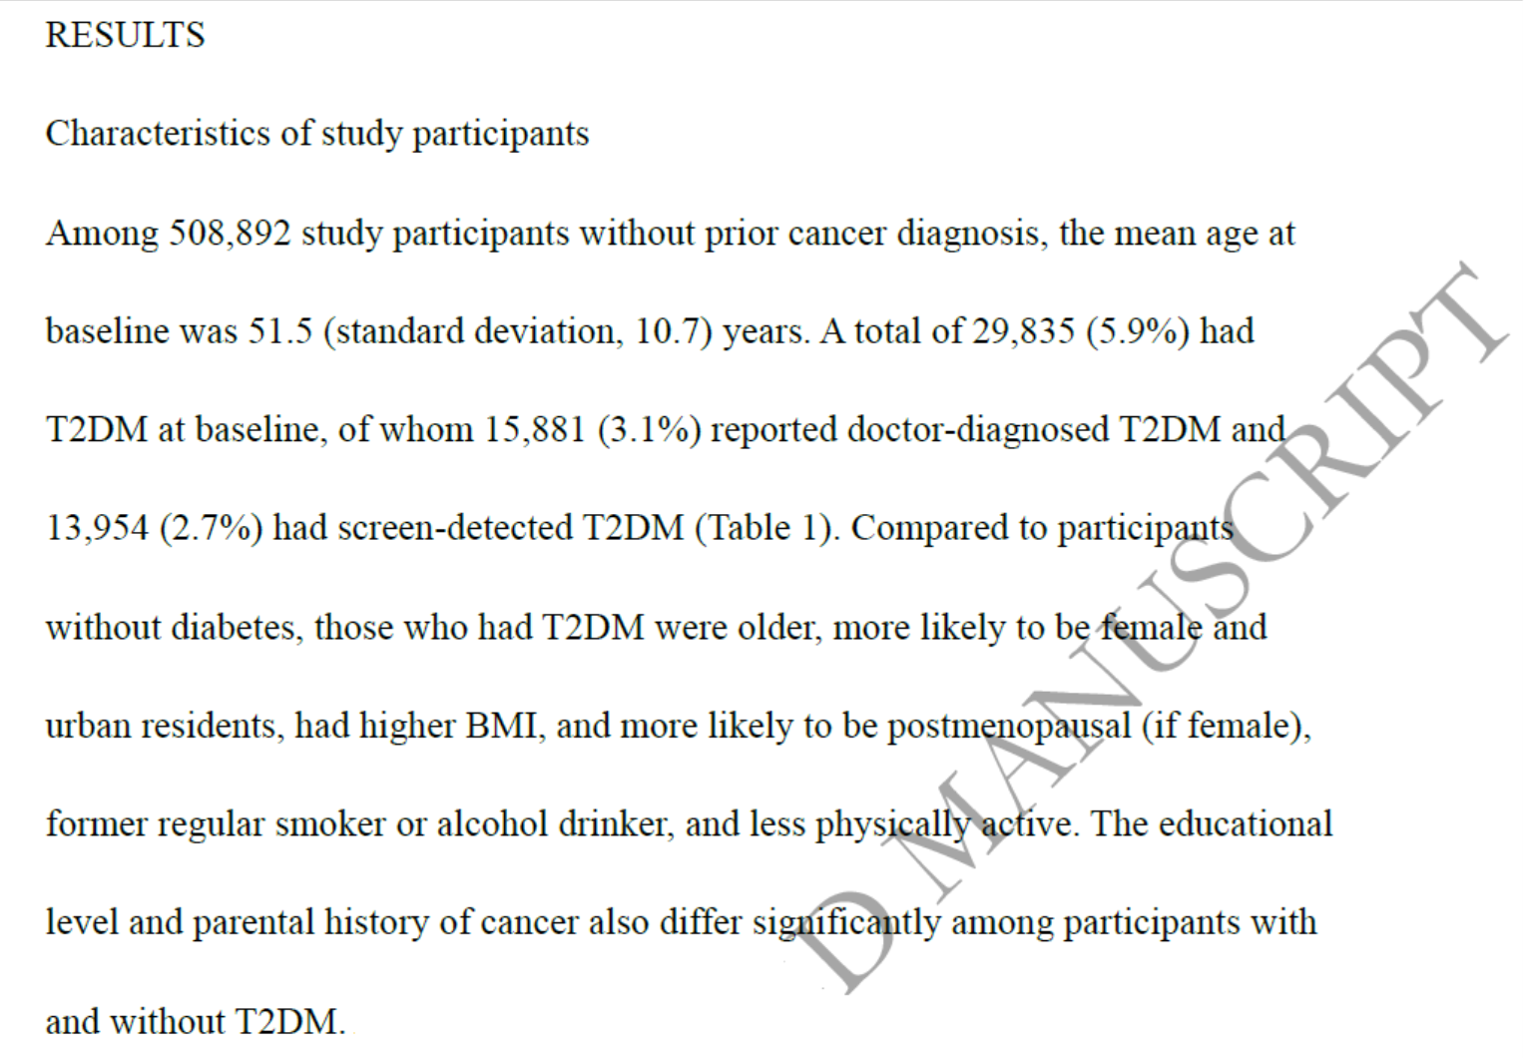

Slide 17
To describe the data shown in Figure 3.3 you can say:
The figure shows that significantly more children with persistent cough had ever used an asthma medication or had used a bronchodilator or preventive medication in the last 12 months compared to asymptomatic children. However, medication use in children with persistent cough was significantly lower than in children with wheeze (P < 0·001).
Notes:
The figure shows the prevalence of medication use in each group so that exact
percentages do not need to be included in the text.
.

Slide 18
Note …
Readers need to be given the messages that can be derived from a table or figure and should not be left to interpret the data themselves

Slide 19
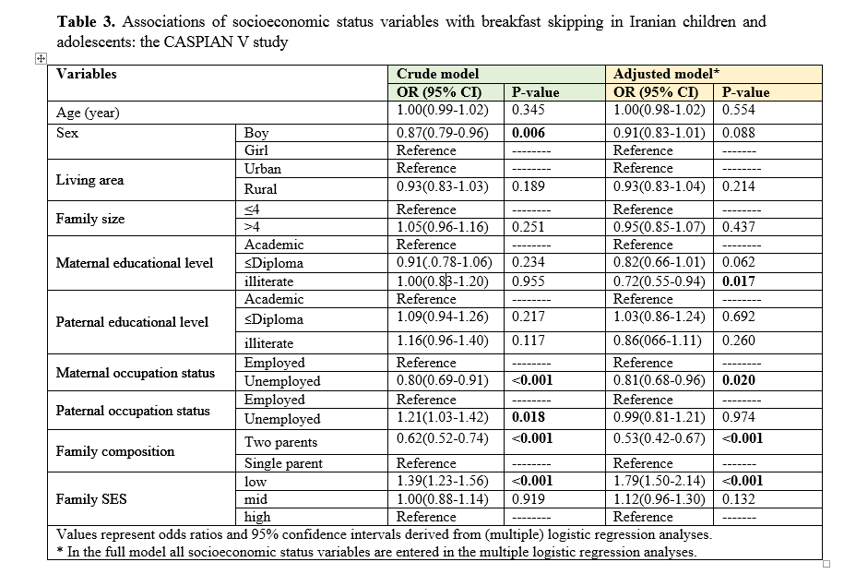

Slide 21
Data analyses: The use of units
It is essential that you are always consistent in the use of units in your reporting so that readers can make valid comparisons between and within groups.

Slide 22
Data analyses: The use of units
Most journals require you to use Système Internationale (SI) units although some American journals have different policies.
For example, JAMA prefers conventional units of measurement with SI units being secondarily expressed in parentheses. Thus, plasma glucose concentrations are published in units of mg/dL instead of mmol/L
Notes:
سیستم بین‌المللی واحدها
واحد های مرسم

Slide 23
Note ..
Never be tempted to call the baseline characteristics the “demographics” of your study sample.
According to the Shorter Oxford Dictionary, demography is the branch of anthropology in which the statistics of births, deaths, and diseases are studied and is therefore not appropriate in this context.

Slide 24
Note ..
In randomised controlled trials, it is better to report descriptive statistics that show the distribution of the variable in each group, rather than using formal statistical tests to determine if the differences between the groups were greater than would have been expected by chance.
Notes:
If you are reporting the baseline characteristics of the participants enrolled in a randomised controlled trial, this is not a time for significance testing.
Hopefully, you did not conduct the study with the purpose of testing whether the baseline characteristics of your participants, who were randomised to study groups, were significantly different merely by chance.

Slide 25
Note ..
By giving readers information of the spread of your data, for example the range or standard deviation, you give them sufficient information to judge differences between groups in terms of their clinical importance
A P value does not help in this.
Statistics such as the standard error or a 95% confidence interval, which are measures of precision, are also inappropriate for this purpose.

Slide 26
Notes:
In Table 3.3, it can be seen that age and all of the characteristics described by percentages are very similar between groups.
Renal function is described using median values, and the difference between groups is small in relation to the range within the groups.
However, despite using random allocation to groups, systolic blood pressure was 10 units lower in the intervention group, which is an effect size of 0·5 standard deviations between groups.
Readers will need to make an expert decision or rely on secondary analyses to decide whether this difference could have biased the final conclusions.

Slide 27
Randomized controlled trials
If you are reporting the results of a randomized controlled trial, you will be required to follow the CONSORT guidelines
The guidelines, which were established by an international panel of researchers, statisticians, and epidemiologists, comprise a comprehensive checklist of 22 requirements to help you report the results of your trial fully and accurately.
Flow chart
Notes:
In following the guidelines, you will need to include a flow chart to show how you recruited your sample and how many people were lost at various points in the
progression of the study.

Slide 28
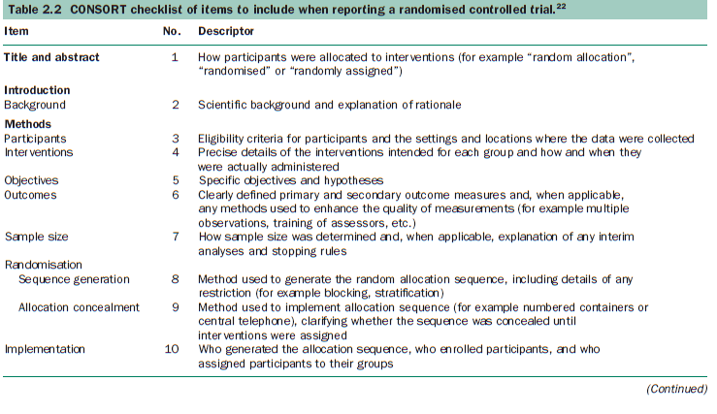
CONSORT guidelines

Slide 29
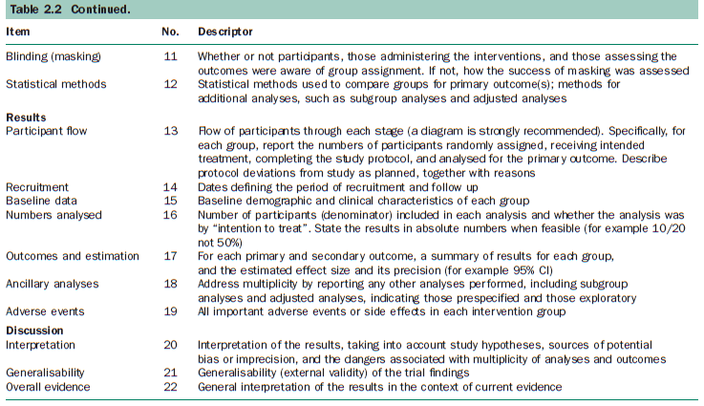
CONSORT guidelines

Slide 30
Case–control studies
Don’t report exposures in the case and control groups as percentages or mean exposure levels in tables of baseline characteristics.
Because these proportions will vary according to the sampling criteria rather than with the prevalence in the general population, they have no inherent epidemiological interpretation and they cannot be compared between studies
Notes:
It is much more valuable if the results are presented as the level of risk that is associated with an exposure, for example as odds ratios.
The frequencies of exposed and unexposed cases and controls can then be presented in tables along with the odds ratios but only for the purpose of making the derivation of the statistics transparent
to the reader and not for making comparisons with other studies.

Slide 31
Interpretation of results
Always try to present your results in an objective and dispassionate way.
Never be tempted to over interpret your findings, no matter how passionately you believe in your hypothesis and no matter how desperately you want it to be proved.
It is much better to limit yourself to describing exactly what you found.

Slide 32
Interpretation of results
For example do not say:… There was an extremely high incidence of disease in the study population.
a highly emotive and subjective statement …
It is better to present straight facts such as, The incidence of disease was higher than has been measured previously.
If you need to shout about your results, it is best to do so in private.

Slide 33
Note ..
You must never state that there was a difference between your study groups when the P value is greater than 0·05.

Slide 34
Note …
You must refrain from making statements such as, The active group had a larger change from baseline than the control group, although the difference did not reach statistical significance.
There was a difference between groups although there wasn’t!!!
Basically, there is a statistically significant difference between groups or there isn’t.
Notes:
These contradictions are confusing in that they suggest that there was a difference between groups although there wasn’t.

Slide 35
Note
Similarly, an important concept is that differences between groups that are almost significant, such as those with a P value between 0·051 and 0·1, are not significant.
Marginally non significant (> 0.05, e.g: 0.053) or Marginally significant (< 0.05, e.g : 0.048)

Slide 36
Note ..
A P value is merely the probability that a result has arisen by chance.
Don’t confuse effect size with study size…
The smaller P value the more untenable the null hypothesis.
Notes:
دفاع نشدنی تر!!

Slide 37
Note ..
In studies with a large sample size, small differences between groups will become statistically significant simply because the 95% confidence intervals are narrow, precise estimates.

Slide 38
Note
Basically, it’s up to you to interpret your P values in terms of the study size, the outcomes measured, and the clinical or public health importance of the results.

Slide 39
Example
In measuring the effects of parental smoking on the respiratory health of children, it has been important to conduct very large studies to show that small odds ratios of 1·2 or 1·3 are statistically significant.
Although this risk is small, it is important in population terms because rates of exposure to parental smoking are frequently as high as 40% of the population.
On the other hand, large and clinically important effects may not reach statistical significance in studies with a small sample size.
Notes:
and therefore the absolute number of children in the population who have symptoms as a result of exposure is large
If only a small per cent of children were exposed, a small odds ratio for an outcome that does not have significant clinical implications would indicate that the exposure was of
negligible importance to public health.

Slide 40
Interpreting marginal P values
In interpreting marginal P values, much depends on the size of the difference between the groups and the size of the study sample.
if the sample size was large and the difference between groups was small, a marginal P value should probably be ignored.

Slide 41
Interpreting marginal P values
If there was a clinically important difference between the groups but the sample size was small, a marginal P value would suggest that a type II error had occurred:
“The difference between the groups would normally be considered to be clinically important but, because of the small sample size, did not reach statistical significance.”

Slide 42
Note ..
Finally, do not labour your results by repeating P values in the text that you have already listed in a table.
For example, you do not need to report that A high body mass index was associated with an increased prevalence of shortness of breath (P = 0·004).
However you will need to include the P value in the abstract.

Slide 43
Notes:
In essence, most numbers are reported as digits except in some special circumstances.
In summarising your data, try not to imply more precision
than your sample size provides.
If you have more than 100 participants in a study group, it is probably OK to report
percentages with just one decimal point.
However, if you have fewer than 50 participants in the group, then each participant
will represent more than 2% of the sample. In this case, it is
best to use whole percentages
only. If the sample size is fewer than 20 and each participant constitutes more than 5% of the
sample, the use of whole numbers is more honest.
Similarly,
report results with only the same number of decimal places as
the measurement itself or perhaps one extra decimal place
that is reasonable for a summary statistic.

Slide 44
Tables
If many rows or columns are being presented, it is a good idea to consider dividing the table into two.
It is also important to keep tables as simple as possible.
Row and column headings should be brief but sufficiently explanatory.
Standard abbreviations of units of measurements should be added in parentheses.
Notes:
Tables are invaluable for presenting numerical results but should not be too large.
Take a look in any journal and you will see that published
tables do not have multiple borders and grids.

Slide 45
Tables
In the majority of journals, scientific tables have few horizontal rules and no vertical rules
You should format your tables in this way with sufficient white space to separate the rows and columns.

Slide 46
Example
Notes:
As recommended, Table 3.5 also contains the group
numbers. In this case the numbers are included in the column
titles but they could also be presented as the first line of the
table.
Inclusion of sample or group sizes helps readers to
interpret the data correctly and calculate other statistics that
may be of interest to them.
It is not a good idea to include sample or group sizes at the base of a table.
Table 3.5 is constructed so that it is clear how the summary statistics have
been computed and which variables are significant predictors
of anxiety or depression.

Slide 47
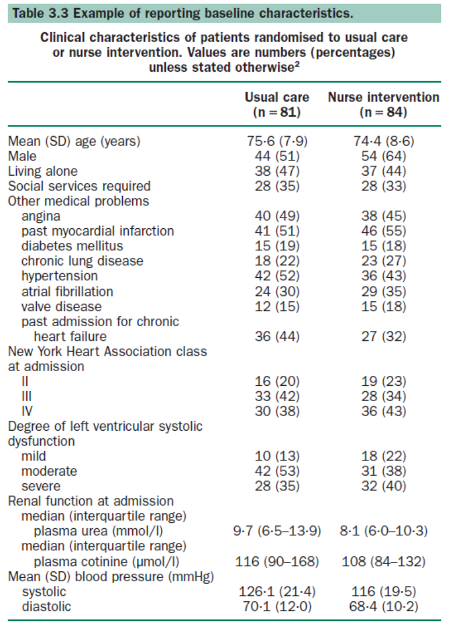

Slide 48
Tables
Most people like to read from left to right.
Thus, groups that are represented by columns and outcome variables that are shown in rows tend to work well.
Notes:
In the table that was shown in Table 3.3, the differences between groups could be easily compared column wise.

Slide 49
Tables
It is better not to present the same data in both a figure and a table, and never to repeat data from figures or tables in the text.
Each table needs a title that tells the reader how to interpret the data.
It is much better to have an inclusive title and detailed row and column descriptors than to put the essential information into footnotes…
Notes:
Readers will not want to search the text, the title, and
the row and the column headings of the table before finally
going to footnotes to find the information that they need
before they can interpret your findings.
It is common practice to print tables one to a page and
include them at the end of the manuscript.
Finally, tables should be submitted on separate pages and not incorporated into the text.

Slide 50
Figures and graphics
A cryptic approach is to show your most important findings as a figure, but only as long as the figure does not take up much more space than reporting the data would.
The figure in which you present your main results should be totally self-explanatory.
A good figure tells the story in a single grab and stays in a reader’s mind.

Slide 51
Figures
Figures that you use in talks to colleagues are often too simplified for a journal article in which all of the details must be included in the absence of any accompanying oral explanations.
However, figures with too much detail become complicated and difficult to understand when the message gets lost in the graphics and the explanations.
Notes:
The symbols, abbreviations, hatching, line types, and bars must all be very clear and must be explained in detail without cluttering the picture.

Slide 52
Figures
Also, the figure legend should be comprehensive so that the figure can be fully understood without recourse to reading explanatory text in the results section.
Notes:
شرح

Slide 53
Notes:
Figure 3.4 shows the magnitude in difference between groups that takes a little longer to work out from the results and statistics presented.
تفاوت بین دو گروه رو نشون میده که اگر بخوایم از متن اونو بفهیمم وقت بیشتری میگیره

Slide 54
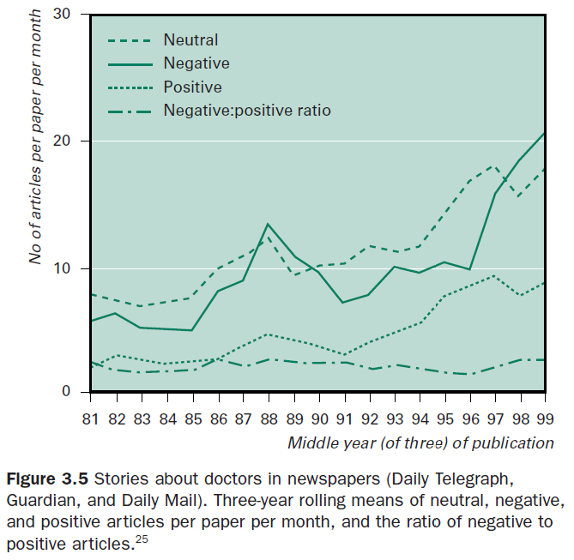
Notes:
Figure 3.5 tells the story almost without having to read the journal article.
کل داستان رو بدون نیاز به خوندن مقاله داره میگه

Slide 55
Figures
Pie charts, which are often useful in oral presentations, have few applications in published journal articles.
They are space greedy, the information cannot usually be used to provide an accurate comparison of results between groups.

Slide 56
Never be tempted to use three-dimensional “box” histograms rather than single dimensional histograms.
Notes:
Such histograms are best left as
marketing tools because the third dimension has no meaning
when presenting scientific results and can create false
impressions. The third dimension is not only distracting and
meaningless but can prevent readers from being able to
interpret the results by comparing the degree of overlap
between the 95% confidence intervals. Multidimensional
histograms are occasionally used to depict the interactive
effects of two factors on an outcome variable and can be useful
in oral presentations. However, the relationship can always be
explained more precisely in a paper by presenting information
from a multivariate model about the absolute size of the
interactive effect and whether it is statistically significant.

Slide 57
Figures
As with tables, figures should be printed on separate pages and included at the end of the manuscript.
Unlike tables, the figure titles, or legends are usually listed on a separate page under the heading “Legends to figures”.

